Slide 1

Problems on CDF 2020

Slide 2
Reference
Data
Youtube
Code

Slide 3
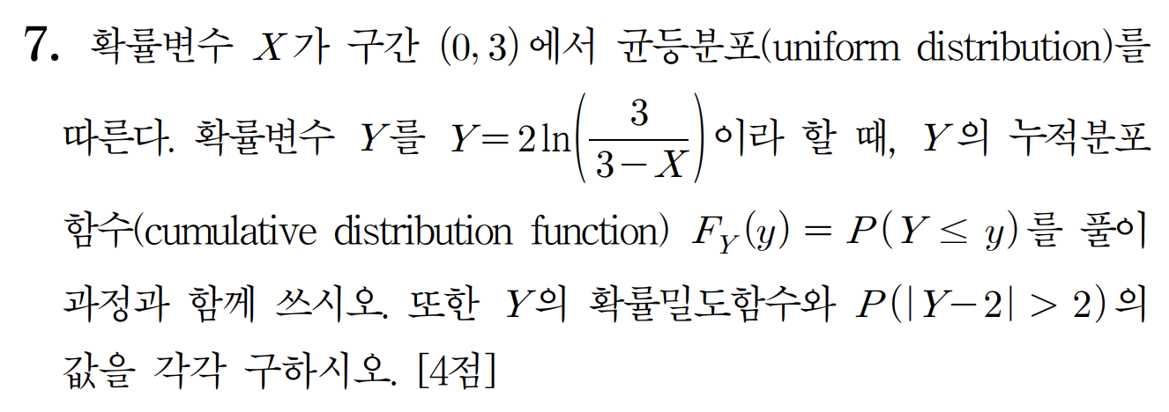
[2020]

Slide 4
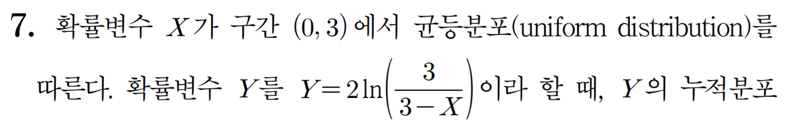

Slide 5
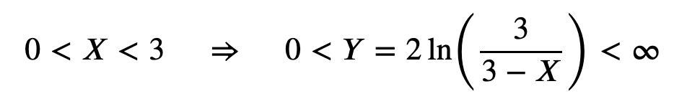

Slide 6
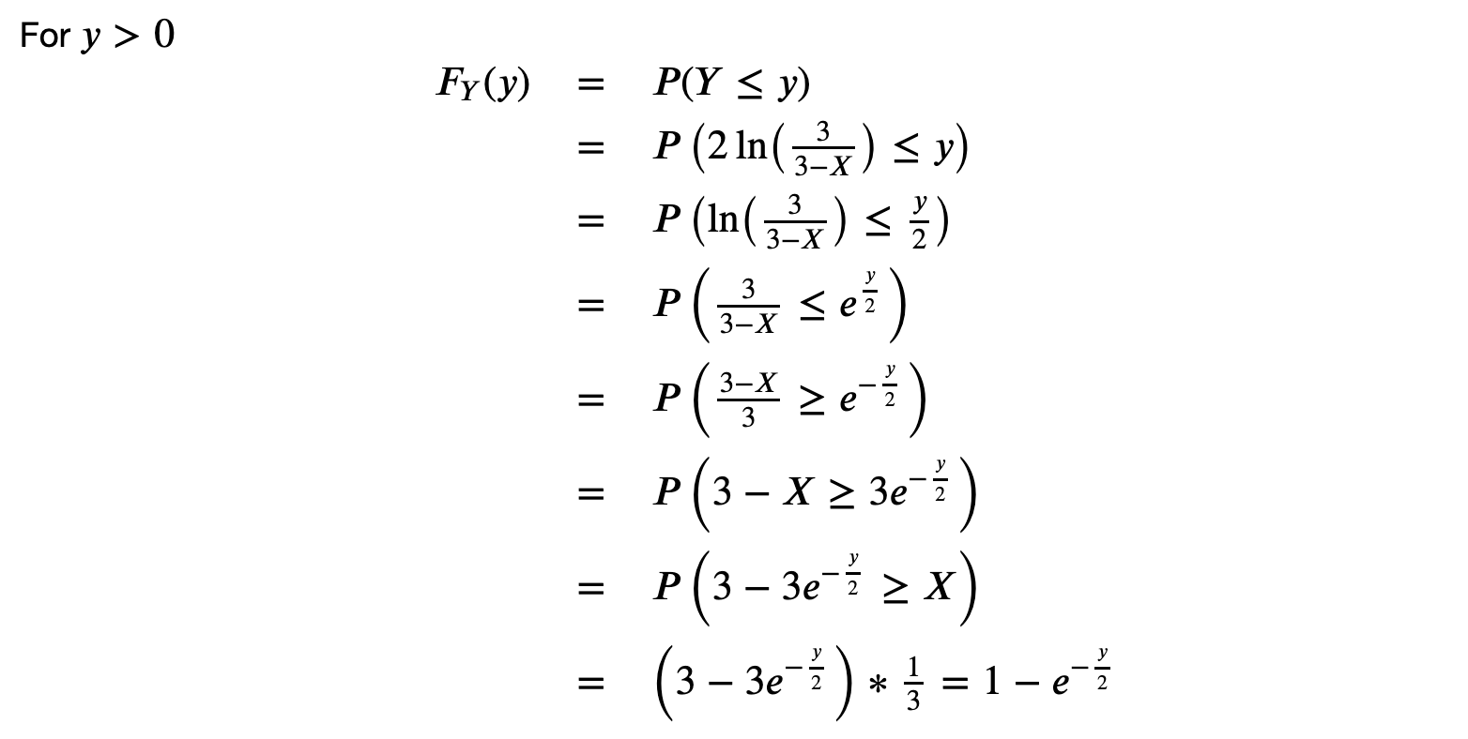


Slide 14


